Slide 1
Risk Management
Roger Pressman

Slide 2
What can go wrong -> Risk Identification
What is the likelihood -> Risk Analysis
What will the damage be? -> Risk Analysis
What can we do about it -> Risk Mitigation

Slide 3
Project risks identify potential budgetary, schedule, personnel (staffing and organization), resource, stakeholder, and requirements problems and their impact on a software project.

Slide 4
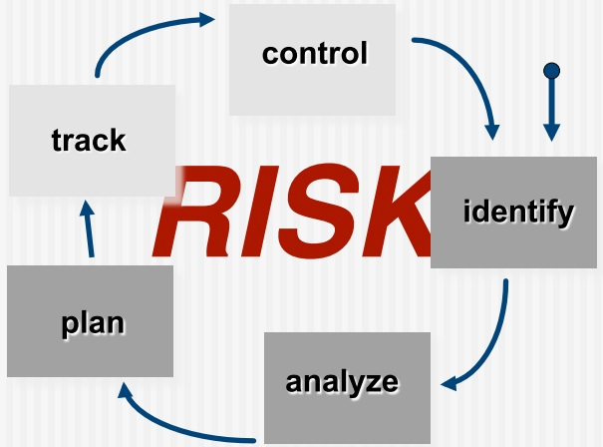

Slide 5
Risk Management Strategies
Reactive
Proactive

Slide 6
Type of Risks
Technical Risk
  If a technical risk becomes a reality, implementation may become difficult or impossible. Technical risks identify potential design, implementation, interface, verification, and maintenance problems. In addition, specification ambiguity, technical uncertainty, technical obsolescence, and “leading-edge” technology are also risk factors. Technical risks occur because the problem is harder to solve than you thought it would be.

Slide 7
Business Risk
  Candidates for the top five business risks are
  building an excellent product or system that no one really wants (market risk).
  building a product that no longer fits into the overall business strategy for the company (strategic risk)
  building a product that the sales force doesn’t understand how to sell (sales risk).
  losing the support of senior management due to a change in focus or a change in people (management risk).
  losing budgetary or personnel commitment (budget risks).

Slide 8
Another categorization
Known risks
  Are those that can be uncovered after careful evaluation of the project plan, the business and technical environment in which the project is being developed, and other reliable information sources (e.g., unrealistic delivery date, lack of documented requirements or software scope, poor development environment).
Predictable risks
  Are extrapolated from past project experience (e.g., staff turnover, poor communication with the customer, dilution of staff effort as ongoing maintenance requests are serviced).
Unpredictable risks

Slide 9
General risks
Product specific risks

Slide 10
Risk Identification generic checklist
Product size—risks associated with the overall size of the software to be built or modified.
Business impact—risks associated with constraints imposed by management or the marketplace.
Stakeholder characteristics—risks associated with the sophistication of the stakeholders and the developer’s ability to communicate with stakeholders in a timely manner.
Process definition—risks associated with the degree to which the software process has been defined and is followed by the development organization.
Development environment—risks associated with the availability and quality of the tools to be used to build the product.
Technology to be built—risks associated with the complexity of the system to be built and the “newness” of the technology that is packaged by the system.
Staff size and experience—risks associated with the overall technical and project experience of the software engineers who will do the work.

Slide 11
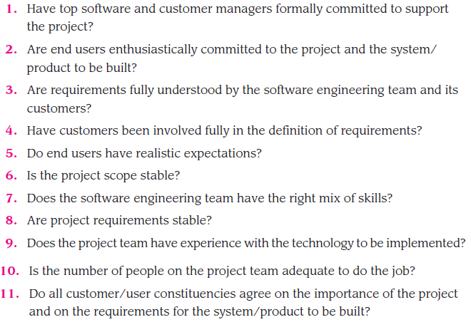

Slide 12
Risk Components and Drivers
The U.S. Air Force [AFC88] has published a pamphlet that contains excellent guidelines for software risk identification and abatement. The Air Force approach requires that the project manager identify the risk drivers that affect software risk components:
Performance
Cost
Support
Schedule.

Slide 13

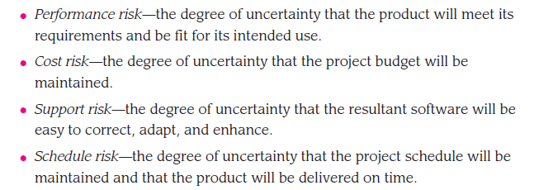

Slide 14
Risk Projection or Risk Estimation
the likelihood or probability that the risk is real
the consequences of the problems associated with the risk, should it occur.

Slide 15
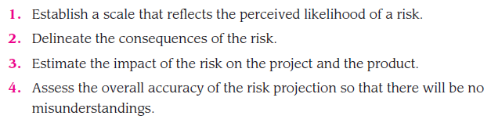
Risk Projection
Perform 4 steps:

Slide 16
Risk Impact
The impact of each risk driver on the risk component is divided into one of four impact categories:
Negligible
Marginal
Critical
Catastrophic.

Slide 17
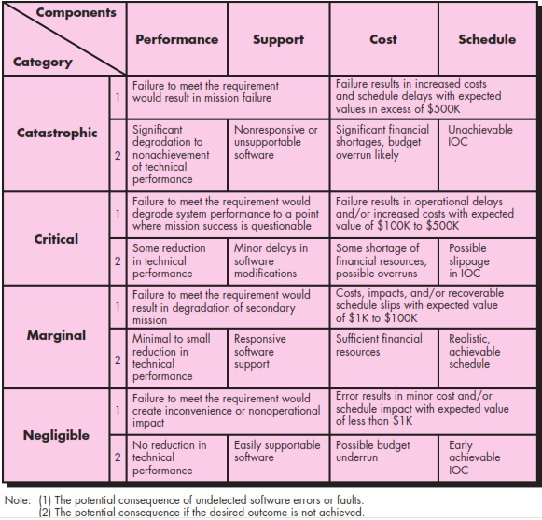

Slide 18
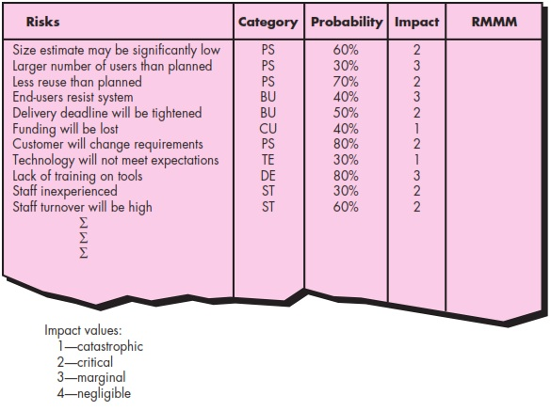
Risk Table

Slide 19
Risk Impact Assessment
Risk Exposure = Probability of Risk x Cost if the Risk occurs
Risk identification. Only 70 percent of the software components scheduled for reuse will, in fact, be integrated into the application. The remaining functionality will have to be custom developed.
Risk probability. 80 percent (likely).
Risk impact. Sixty reusable software components were planned. If only 70 percent can be used, 18 components would have to be developed from scratch (in addition to other custom software that has been scheduled for development). Since the average component is 100 LOC and local data indicate that the software engineering cost for each LOC is $14.00, the overall cost (impact) to develop the components would be:
18 x 100 x 14 = $25,200.
Risk exposure = 0.80 x 25,200 ~ $20,200.

Slide 20
Risk Mitigation
For example, employee turnover:
Meet with current staff to determine causes for turnover (e.g., poor working conditions, low pay, competitive job market).
Mitigate those causes that are under your control before the project starts.
Once the project commences, assume turnover will occur and develop techniques to ensure continuity when people leave.
Organize project teams so that information about each development activity is widely dispersed.
Define work product standards and establish mechanisms to be sure that all models and documents are developed in a timely manner.
Conduct peer reviews of all work (so that more than one person is “up to speed”).
Assign a backup staff member for every critical technologist.

Slide 21
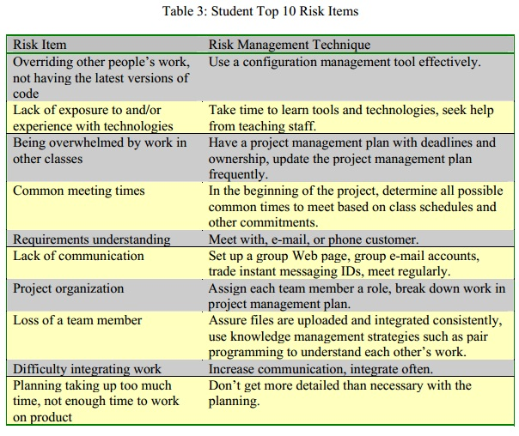
Ref: http://agile.csc.ncsu.edu/SEMaterials/RiskManagement.pdf

Slide 22
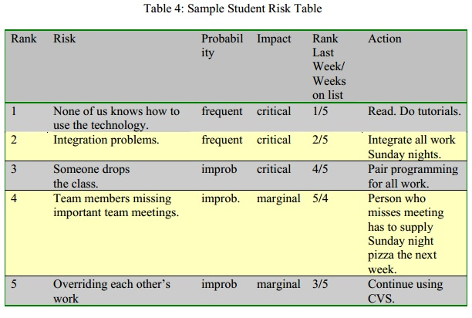
Ref: http://agile.csc.ncsu.edu/SEMaterials/RiskManagement.pdf

Slide 23
Risk Contingency
Plan what to do if risk occurs even after all mitigation efforts.

Slide 24
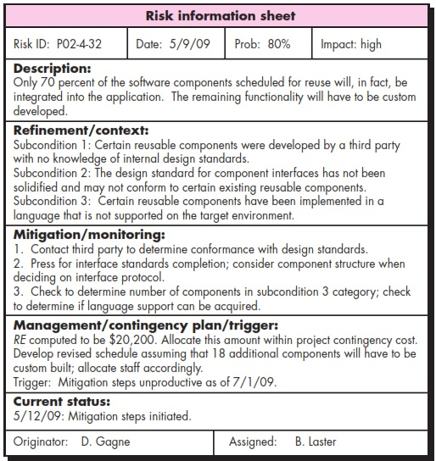

Slide 25
